Slide 1
Iot Based Garage Door Opener: Interfacing Beaglebone with Push Button
Shivinder Kaur
Group 4
C0751078

Slide 2
Content:
Task Objective
Components Required
Introduction to Beaglebone Black
Beaglebone Pin Diagram
Introduction to Push Buttons
Types of Push Button
Basic Structure of Push Button
Connections of Push Button and Beaglebone Black
Connections of LED and Beaglebone Black
Connections of IR sensor and Beaglebone Black
Hardware Connections
Software Coding
Code
Output
References

Slide 3
Task Objective:
The main objective of this task is to control the buzzer.
Whenever something comes in between the door IR sensor will detect the obstacle and then the buzzer will make sound.
So the push button will be pressed to the turn off the buzzer.

Slide 4
Components Required:
Hardware Components:
Beaglebone Black
Push Button
LEDs
Resistors
Jumper wires
USB Cable
Breadboard
Software Components:
PuTTY
Terminal nano
Gcc Compiler
Latest image of debian for beaglebone black
C programming

Slide 5
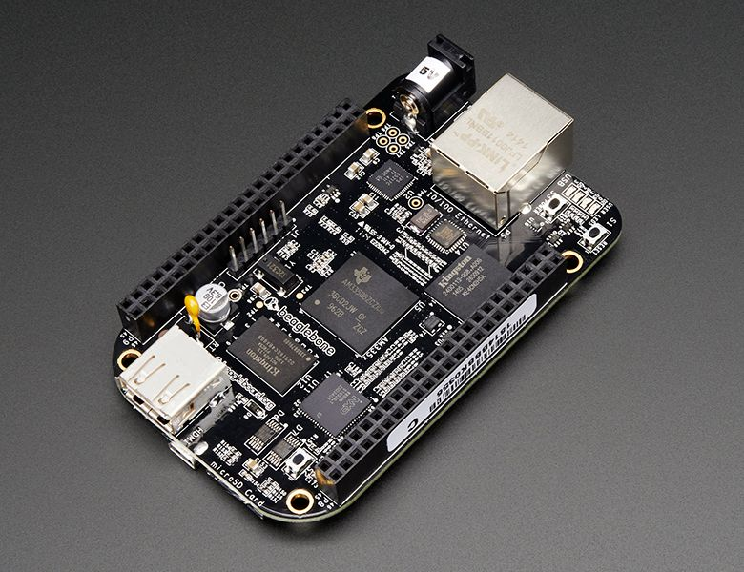
Introduction to Beaglebone Black:

Slide 6
Introduction to Beaglebone Black:
The Beaglebone Black is an affordable single-board credit card sized computer.
It has a powerful ARM Cortex A8 CPU, a full Linux OS, and allows for easy access to external sensors.
512MB DDR3 RAM
Dual PRU 32-bit microcontrollers
4GB eMMC flash storage
Supports ARM compatible Linux 3.8 kernel

Slide 7
Introduction to Beaglebone Black:
It provides a lot of expansion interfaces such as Ethernet, USB host and OTG, TF card, serial, JTAG (no conector by default), HDMI D type, Emmc, ADC, I2C, SPI, PWM and LCD.
It is designed to satisfy the different requirements of various fields including game devices, home and industrial automation, consumer medical devices, printers, intelligent tolling systems, weighing systems of intelligent vending machine, educational terminals and high-end toys.

Slide 8
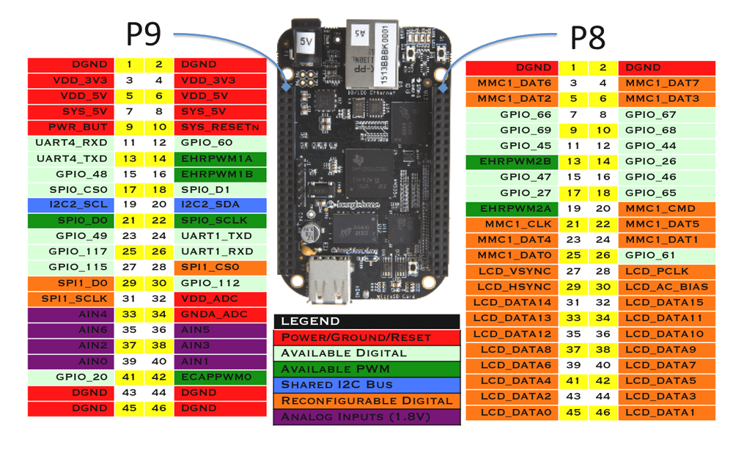
Beaglebone Pin Diagram:

Slide 9
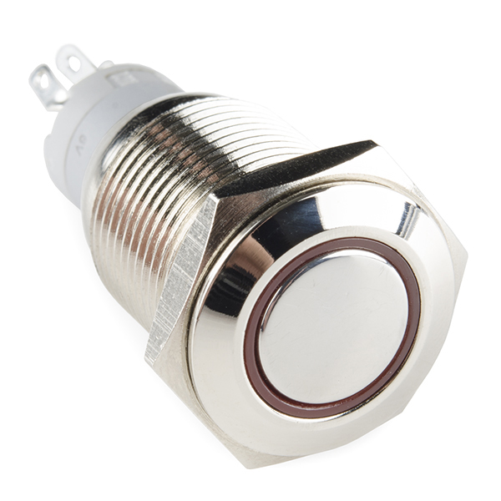
Introduction to Push Buttons:

Slide 10
Introduction to Push Buttons:
In our day to day life we encounter various push button switches such as on medical equipments, automated production lines, and communication equipments. It is a very simple component, but because it controls the entire control circuit, it is also known as “Control Switch”.
The push button is usually used to turn on and off the control circuit, and it is a kind of control switch appliance that is widely used. It is used electrical automatic control circuits to manually send control signals to control contactors, relays, electromagnetic starters, etc.

Slide 11

Introduction to Push Buttons:
Its characteristic is that it is installed in the machine and instrument in the process of work, most of the time in its initial free state position, and only when needed, it is converted to the second state under the action of external force.

Slide 12
Types of Push Buttons:
There are different types of push buttons:
Momentary
Latching
Electric
Pneumatic
“Push to make”
“Push to break”

Slide 13
Types of Push Buttons:
Latching switches will only require the user to press the switch once and will then remain either off or on until pressed again (light switch).
Momentary or latching is terminology used to describe many different switches. A momentary switch will require continuous compression to remain “on” or “off” depending on how the circuit is wired (alarm switches or fail safe circuits).

Slide 14
Types of Push Buttons:
Within the category “momentary switches” there are “push to make” or “push to break” switches. A “push to make” switch is wired normally open or “off” when the button is compressed the electric circuit will connect - the switch will “make” the circuit. For example door bells.
A “push to break” switch will be used on a circuit which is wired normally “closed” or “on”. When the switch is compressed the circuit will break and the device will be switched off. These types of push button switches are used in alarms, refrigerator lights.

Slide 15
Types of Push Buttons:
Electric push button switches are used within electric circuits like light switches. They contain electronics required to make or break circuits depending on the application.
Pneumatic push button switches do not contain electronics, instead, when actuated a puff of air is passed through to an air switch which then completes the circuit.

Slide 16
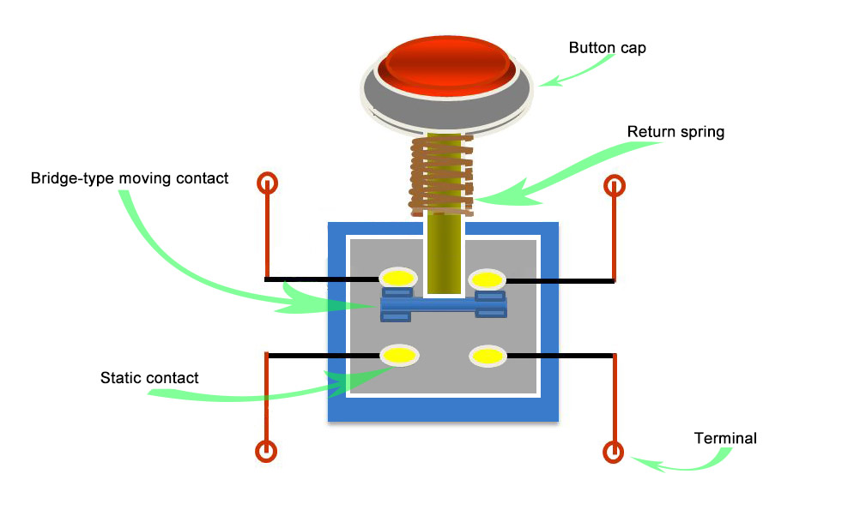
Basic Structure of Push Button:

Slide 17
Connections of Push Button with Beaglebone Black:
One pin of push button has been connected to pin 41 of port 9 (P9.41) of Beaglebone Black.
The resistor of 10K has been connected in between push button and Beaglebone Black.
3.3V power supply has been connected to the other pin of push button.

Slide 18
Connections of Beaglebone Black with LED:
LED has been connected to the beaglebone black for the demonstration.
The positive(+) pin of LED has been connected to pin 12 of port 8(P8.12) of beaglebone black.
The negative (-) pin of LED has been grounded.

Slide 19
Connection of IR sensor and Beaglebone Black:
The output pin of IR Sensor is connected to pin 7 of header 8 (P8.7) of beaglebone black.
5V power supply is connected to Vcc pin of IR sensor.
Both GND pins of IR sensor and beaglebone black are connected to each other.

Slide 20
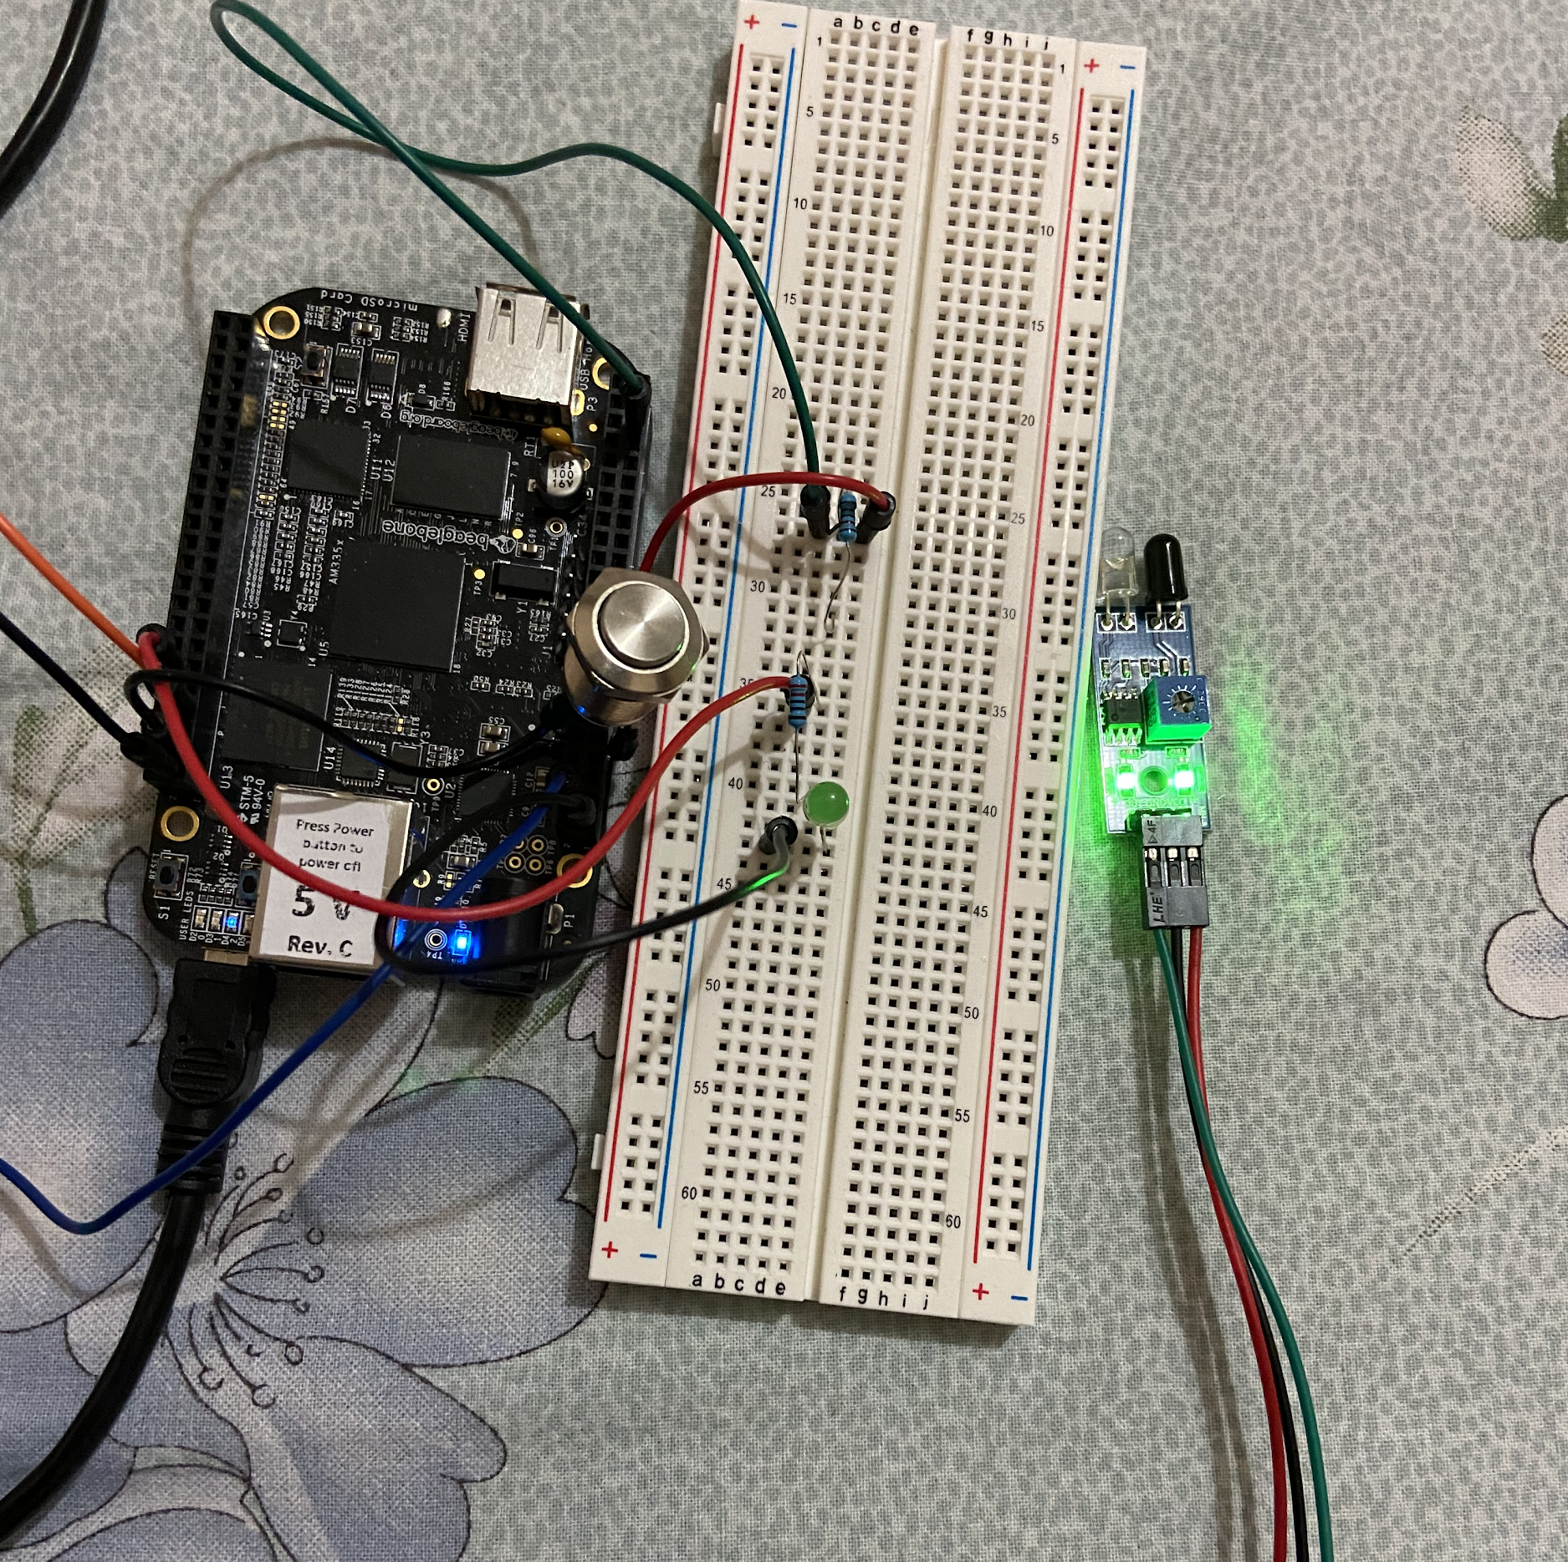
Hardware Connections:

Slide 21
Software Coding:
As I am using Windows Operating System, so I have downloaded PuTTY software for beaglebone black.
So we have to login into beaglebone black by putting the IP address i.e., 192.168.7.2
After that the terminal window will open and then login as debian and then put password.
Then I opened the nano terminal by first making a folder named push_button and then nano pshbtn.c.
Write the code for interfacing and save it by Ctrl+O and then exit Ctrl+X.
Compile the program through gcc command i.e. gcc pshbtn.c -o pushbutton -l iobb
After compiling run the program by sudo ./pushbutton.

Slide 22
Code:
Step 1: Including Header files
#include <stdio.h> //includes standard I/O header files
#include <iobb.h> //includes GPIO I/O header files
#include <unistd.h> //includes POSIX API library for adding delay in operation

Slide 23
Code:
Step 2: Defining Pins
#define GreenLED 8,12 //pin 12 of header 8
#define PushButton 9,41 //pin 41 of header 9
#define IRbtwnDoor 8,7 //pin 7 of header 8

Slide 24
Code:
Step 3: Beginning of main function and setting the directions of GPIO pins
int main(void) // main function
{
iolib_init(); // initializing GPIO I/O library
iolib_setdir(IRbtwnDoor, DigitalIn); //setting GPIO pin of IR sensor for input
iolib_setdir(GreenLED, DigitalOut); //setting GPIO pin of LED
iolib_setdir(PushButton, DigitalIn); //setting GPIO pin of push button for input

Slide 25
Code:
Step 4: Logic for operation
while(1) //continuous loop
{
if (is_high (IRbtwnDoor)) //if pin 7 of header 8 is low
{
printf(“Door Closed \n”); //print on terminal
pin_low(GreenLED); // LED will not glow
usleep (1200000); //delay operation
}
if (is_low (IRbtwnDoor)) //if pin 7 of header 8 is high
{
printf(“Obstacle \n”); //print on terminal
pin_high(GreenLED); // LED will glow
usleep (1200000); //delay operation
if (is_high (PushButton)) //when button is pressed
{
printf(“Buzzer is off \n”); //print on terminal
pin_low(GreenLED); // LED will not glow
usleep (1200000); //delay operation
}
}

Slide 26
Code:
Step 4: End of Program
}
iolib_free(); //end of program (free library resources)
return(0); //return a value
}

Slide 27
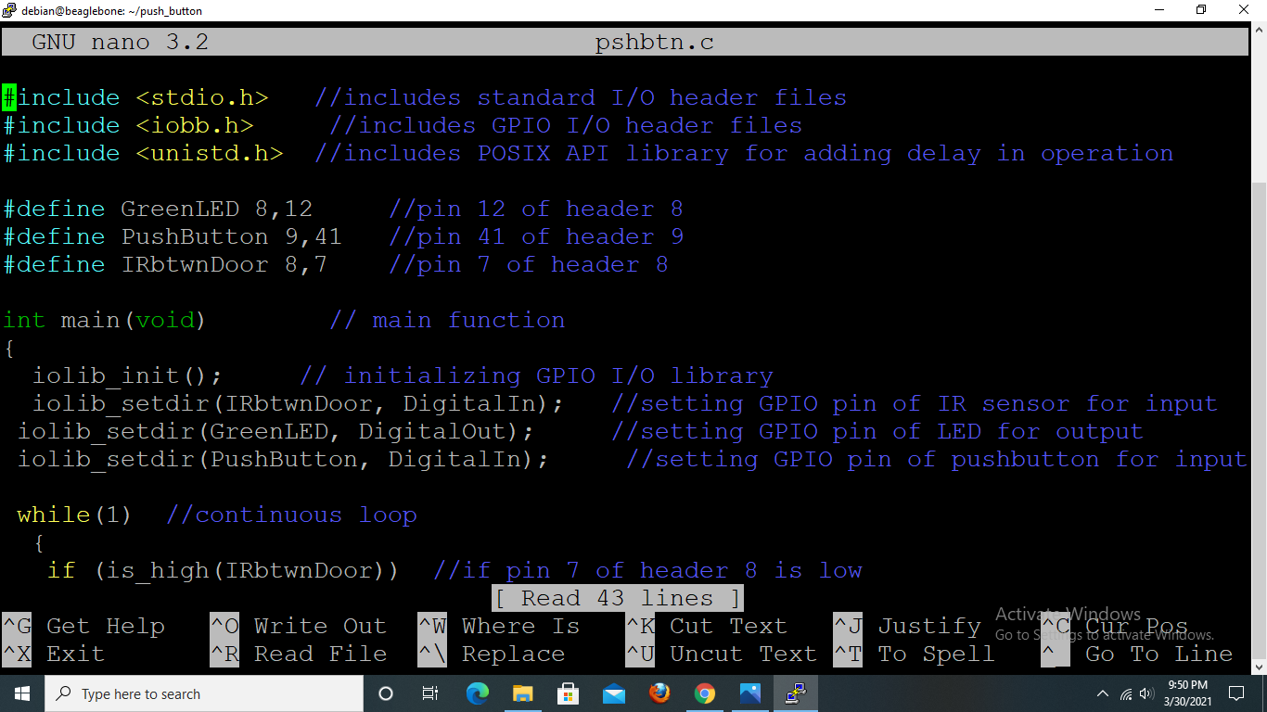
Code:

Slide 28
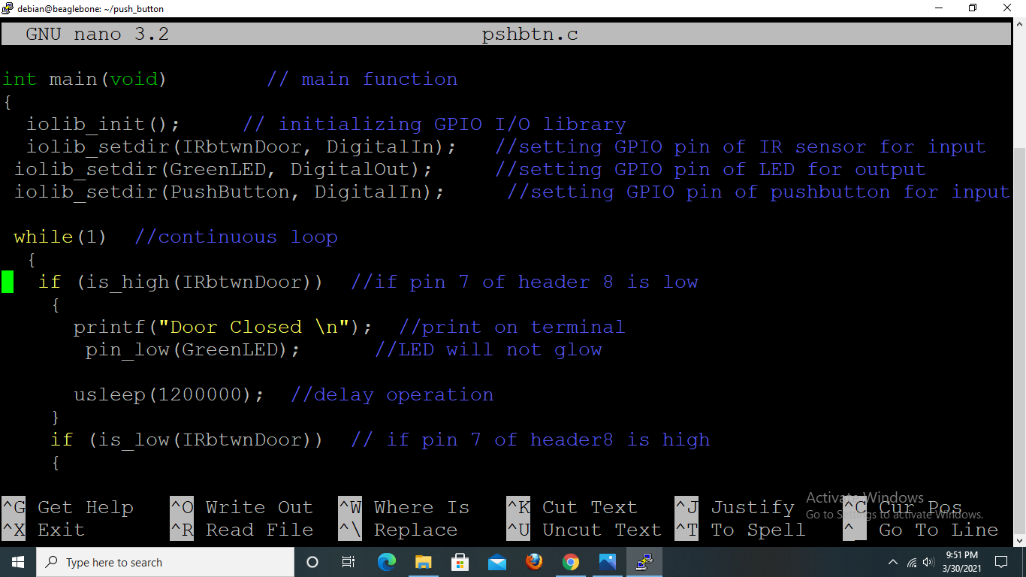
Code:

Slide 29
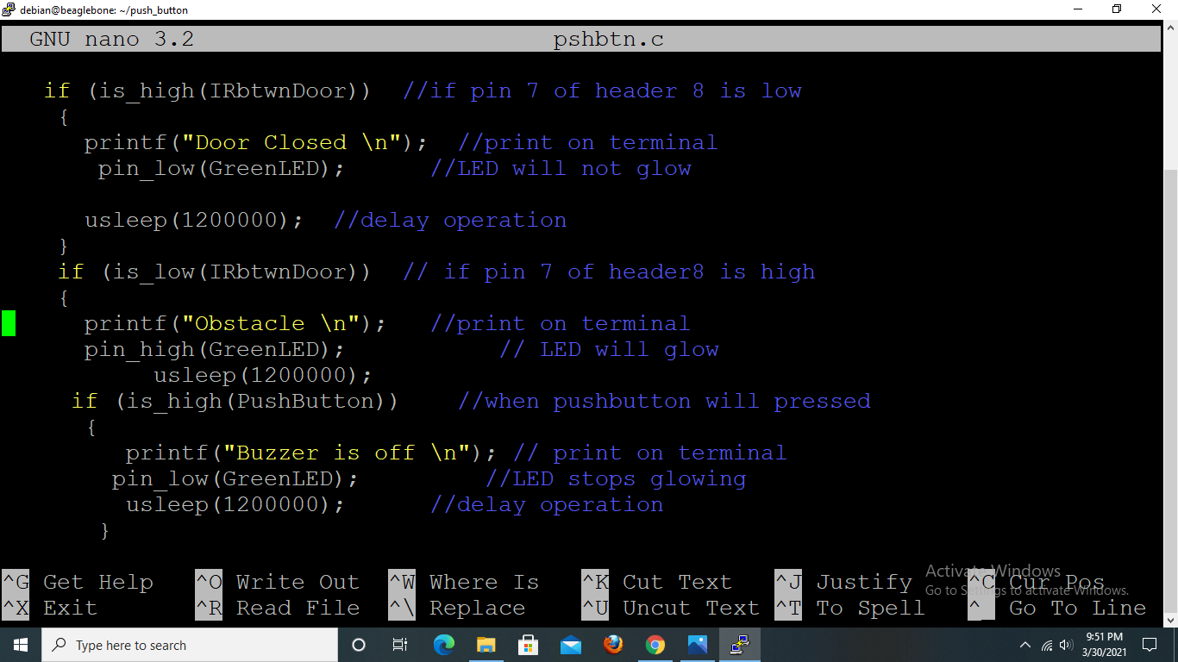
Code:

Slide 30
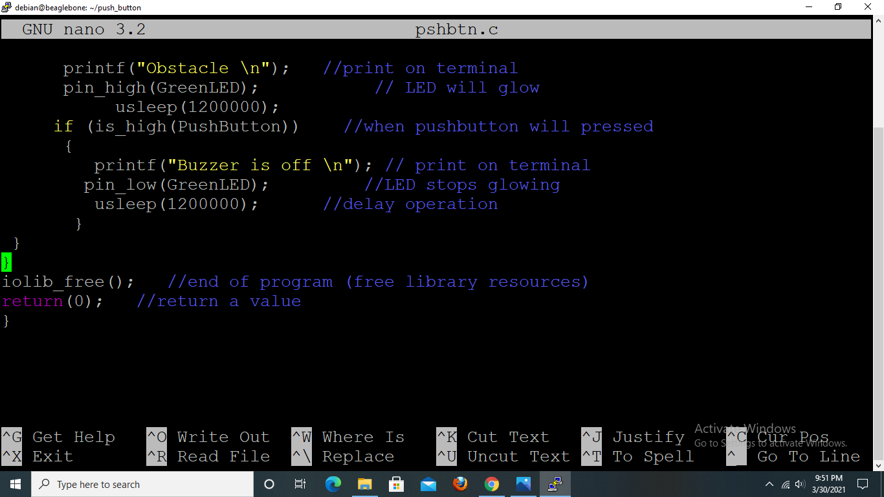
Code:

Slide 31
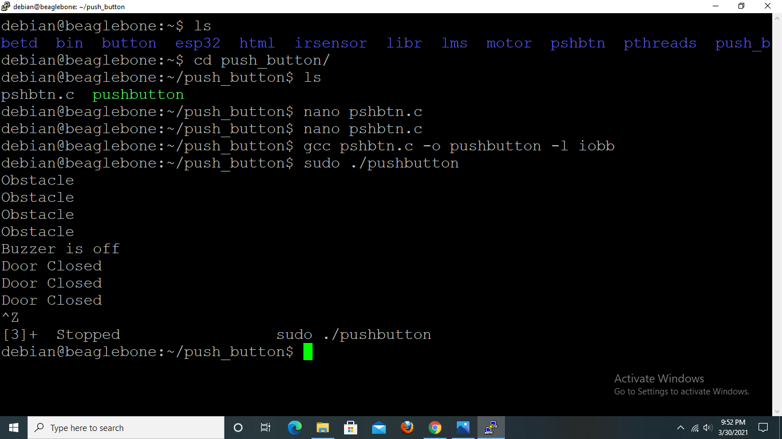
Output:

Slide 32
References:
Beaglebone.org (2019,September 6). Retrieved from https://beagleboard.org/black
Push Button: Quisure.com, Retrieved from, https://www.quisure.com/blog/faq/what-is-the-principle-of-the-push-button-switches Herga Technology Ltd., Retrieved from, https://www.herga.com/pressrelease/detail.php?aid=129&did=Push-Button-Switch-Types
Code: Element14.com, Retrieved from, https://www.element14.com/community/community/designcenter/single-board-computers/next-genbeaglebone/blog/2013/10/10/bbb--beaglebone-black-io-library-for-c
For Connections: Adafruit.com, Retrieved from, https://learn.adafruit.com/connecting-a-push-button-to-beaglebone-black/wiring

Slide 33


